Slide 1
Web Analytics (Project Assignment) Topic: Urban Planning (Singapore)
Group Member:
Sen Poh Swee (Part Time/ G1901954D)
Sim Shu Biao Desmond (Full Time/ G1901940G)
Hon Jia Yu Samuel (Part Time/ G1902020G)
Leong Yew Wing (Part Time/ G1902405D)

Slide 2
Content
Introduction
Motivation
Methods
Experiment
Conclusion and Recommendation
Implementation

Slide 3
Why is Urban Planning is getting importance during these days ?
To keep up with the population growth and infrastructure
Overcrowding in Transportation
Demand & Supply for Housing
Challenge for Major Cities in the world
Singapore, Manila, Mumbai, Paris etc.
Case Study: Singapore

Slide 4
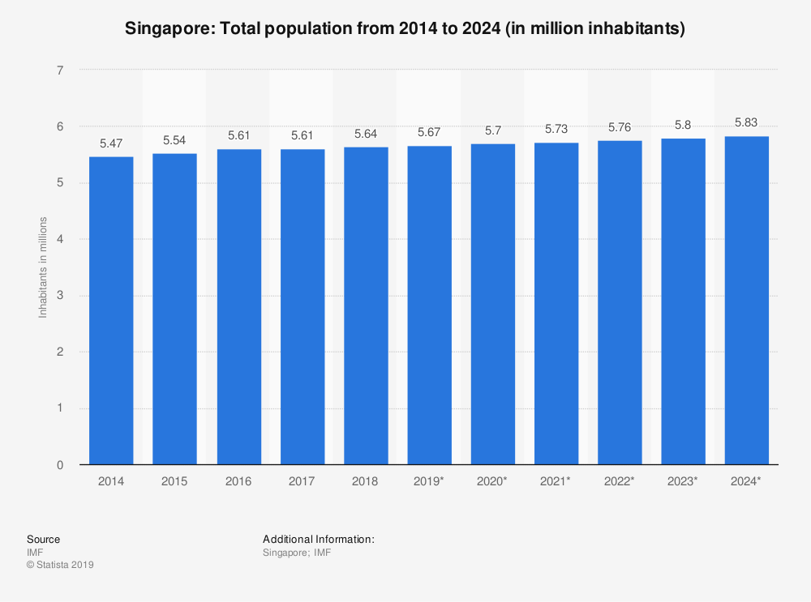
Singapore Population Growth

Slide 5
Population White Paper (PWP)
From Wikipedia….
Released in Jan’2013 by SG GOV on Population Projection:
to raise from 5.4M (2013) to 6.9M (2030)
Criticisms from Singaporeans
“…. attributed the government's population as the cause of overcrowding and falling reliability of its public transportation system, increasing property prices for housing……….”

Slide 6
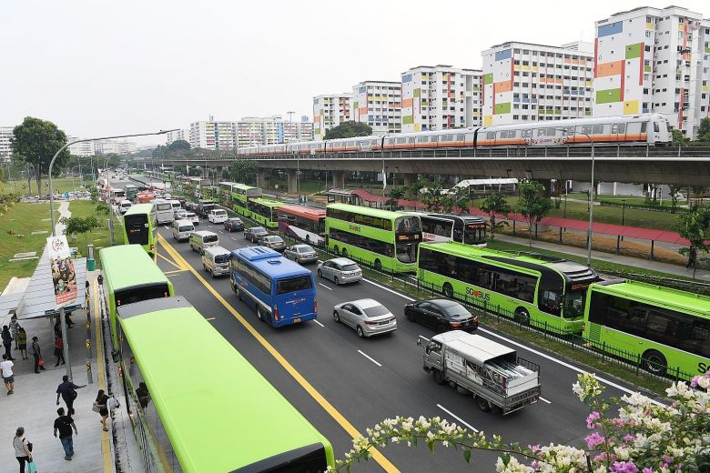
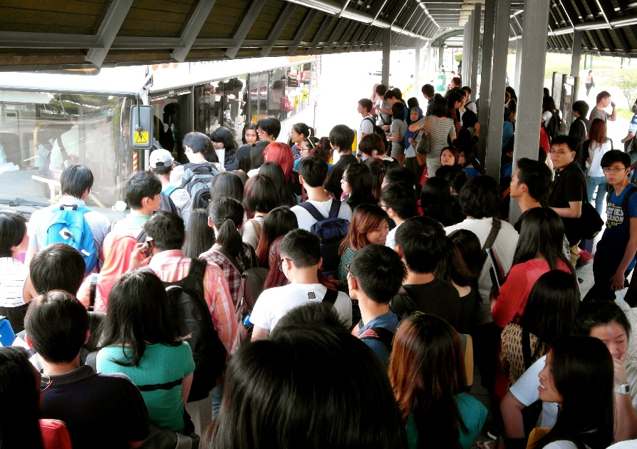
Issues
Traffic Jam – Yishun Integrated hub
Congested Bus Stop – Temasek Polytechnic
Raise Concerns in Public Transportation

Slide 7
One of Initiatives from SG GOV Under “Smart Nation”
Land Transport Authority (LTA)
Publishes land transport-related datasets (particularly to bus) since 2016
Audience
enterprises, researchers, public, anybody
Aim:
To promote collaboration and co-creation of innovative and inclusive transport solutions.
DataMall - MyTransport.SG

Slide 8
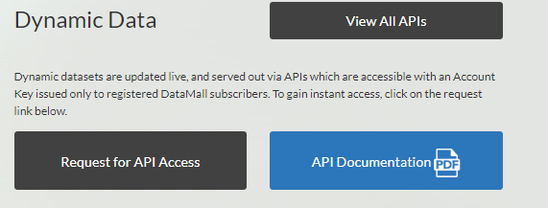
DataMall - MyTransport.SG
Click to register for the request

Slide 9

Related Works from DataMall
http://www.lihaoyi.com/post/PlanningBusTripswithPythonSingaporesSmartNationAPIs.html#improvements
Li Haoyi - Software Engineer
Notes:
Do you who is the\is person? He is the son of our Prime Minister Lee Hsieng Long. His name call Li Haoyi who is a software engineer. He has posted a python code on planning of bus trip based on dataset from DataMall.

Slide 10
Singapore Population Distribution https://www.citypopulation.de/en/singapore/cities/
Name | Area | Population 30/6/1999 | Population 30/6/2009 | Population 30/6/2019 | Estate
Ang Mo Kio | NE | 180,112 | 179,297 | 163,950 | Mature
Bedok | E | 284,318 | 294,519 | 279,380 | Mature
Bishan | C | 89,746 | 91,298 | 88,010 | Mature
Bukit Batok | W | 126,200 | 144,198 | 153,740 | Non-Mature
Bukit Merah | C | 148,299 | 157,122 | 151,980 | Mature
Bukit Panjang | W | 96,031 | 128,734 | 139,280 | Non-Mature
Choa Chu Kang | W | 136,105 | 173,291 | 190,890 | Non-Mature
Clementi | W | 90,864 | 91,874 | 92,420 | Mature
Geylang | C | 118,565 | 120,690 | 110,200 | Mature
Hougang | NE | 203,402 | 216,697 | 226,240 | Mature
Jurong East | W | 88,883 | 88,118 | 79,240 | Mature
Jurong West | W | 203,838 | 267,524 | 264,860 | Mature
Kallang | C | 92,099 | 99,559 | 101,520 | Mature
Pasir Ris | E | 116,245 | 133,863 | 148,020 | Non-Mature
Punggol | NE | - | 59,386 | 170,560 | Non-Mature
Queenstown | C | 97,684 | 98,502 | 96,340 | Mature
Sembawang | N | 31,418 | 72,732 | 95,920 | Non-Mature
Sengkang | NE | 60,870 | 167,054 | 244,600 | Non-Mature
Serangoon | NE | 122,205 | 124,782 | 116,310 | Mature
Tampines | E | 252,448 | 261,743 | 256,730 | Mature
Toa Payoh | C | 121,004 | 124,653 | 120,650 | Mature
Woodlands | N | 186,805 | 245,109 | 254,730 | Non-Mature
Yishun | N | 176,689 | 185,214 | 220,320 | Non-Mature
Notes:
There is no proper definition for mature and non-mature estate in HDB website. We define ourselves that If there are population growth conservatively on both 1999 and 2009, then it will consider as Non-Mature, otherwise it will consider as Mature. Clementi, Hougang and Kallang are considered as Mature although have achieved population growth on 1999 and 2009, but their growth are less than 10%

Slide 11
Motivation
To study about the bus network in Singapore based on Population

Slide 12

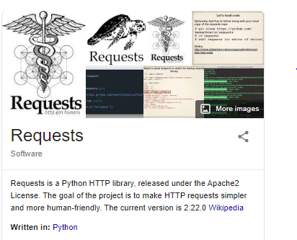
Setting
1. Main Python Modules
Requests –extract HTTP from DataMall
Json – create readable data format to read from Javascript
Networkx –create network graph

Slide 13
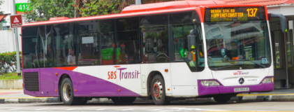
Setting
2. Considering:
Bus Stop as “Node”
Bus Route as Edge (To link node together)
Indicate weight and direction based on distance between the pair node
Bus Stop A
Sequence = 1
Bus Stop B
Sequence = 2

Slide 14
Setting
3. Select 3 x mature and 3 x non mature estate based on population
Mature (M) | Non-Mature (NM)
Hougang (NE) Pop: 226,240 | Sengkang (NE) Pop: 244,600
Ang Mo Kio (NE) Pop: 163,950 | Bukit Batok(W) Pop: 153,740
Tampines (E) Pop: 256,730 | Woodlands (N) Pop: 254,730
Notes:
Selection are made on having the population that are closed to each other
Hougang VS Sengkang – Locate next to each other under NE region
Ang Mo Kio is the gateway between North and Centre and Bujit Batokis the gateway between North and West
Tampines and Woodlands are considered regional hub for east and north respectively.

Slide 15
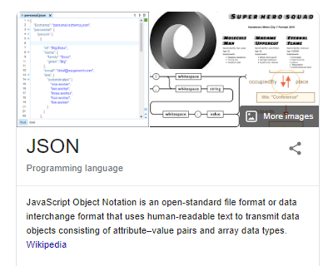
Method 1. Raw Dataset
After you have registered an account on request for API access @ DataMall
Request and extract the following into JSON format:
Bus Stop
Bus Routes

Slide 16
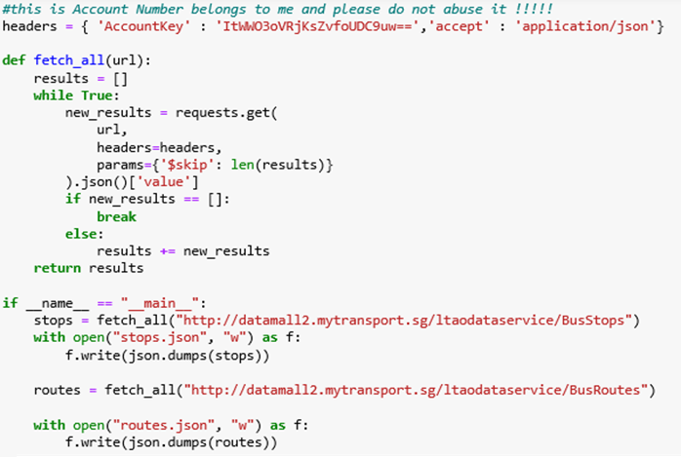
Method 1. Raw Dataset
Given by a LTAMall after registered
Go to URL,
Specific header
Skip page filter (eg. 50 or 100 results)
Raw Dataset for bus stops and routes

Slide 17
Raw Dataset for Bus Stops (Json Format)
Example
"BusStopCode": "01012", "RoadName": "Victoria St", "Description": "Hotel Grand Pacific", "Latitude": 1.29684825487647, Longitude": 103.85253591654006}, {"BusStopCode": "01013", "RoadName": "Victoria St", "Description": "St. Joseph's Ch", "Latitude": 1.29770970610083, "Longitude": 103.8532247463225}, {"BusStopCode": "01019", "RoadName": "Victoria St", "Description": "Bras Basah Cplx", "Latitude": 1.29698951191332, "Longitude": 103.85302201172507}, {"BusStopCode": "01029", "RoadName": "Nth Bridge Rd", "Description": "Opp Natl Lib", "Latitude": 1.2966729849642, "Longitude": 103.85441422464267}, {"BusStopCode": "01039", "RoadName": "Nth Bridge Rd", "Description": "Bugis Cube", "Latitude": 1.29820784139683, "Longitude": 103.85549139837407}, {"BusStopCode": "01059", "RoadName": "Victoria St", "Description": "Bugis Stn Exit B", "Latitude": 1.30075679526626, "Longitude": 103.85611040457583}, {"BusStopCode": "01109", "RoadName": "Queen St", "Description": "Queen St Ter", "Latitude": 1.30358577565355, "Longitude": 103.85650372998224},/

Slide 18
Raw Dataset for Bus Services (Json Format)
Example
[{"ServiceNo": "10", "Operator": "SBST", "Direction": 1, "StopSequence": 1, "BusStopCode": "75009", "Distance": 0, "WD_FirstBus": "0500", "WD_LastBus": "2300", "SAT_FirstBus": "0500", "SAT_LastBus": "2300", "SUN_FirstBus": "0500", "SUN_LastBus": "2300"}, {"ServiceNo": "10", "Operator": "SBST", "Direction": 1, "StopSequence": 2, "BusStopCode": "76059", "Distance": 0.6, "WD_FirstBus": "0502", "WD_LastBus": "2302", "SAT_FirstBus": "0502", "SAT_LastBus": "2302", "SUN_FirstBus": "0502", "SUN_LastBus": "2302"}, {"ServiceNo": "10", "Operator": "SBST", "Direction": 1, "StopSequence": 3, "BusStopCode": "76069", "Distance": 1.1, "WD_FirstBus": "0504", "WD_LastBus": "2304", "SAT_FirstBus": "0504", "SAT_LastBus": "2304", "SUN_FirstBus": "0503", "SUN_LastBus": "2304"}, {"ServiceNo": "10", "Operator": "SBST", "Direction": 1, "StopSequence": 4, "BusStopCode": "96289", "Distance": 2.3, "WD_FirstBus": "0508", "WD_LastBus": "2308", "SAT_FirstBus": "0508", "SAT_LastBus": "2309", "SUN_FirstBus": "0507", "SUN_LastBus": "2308"},..

Slide 19
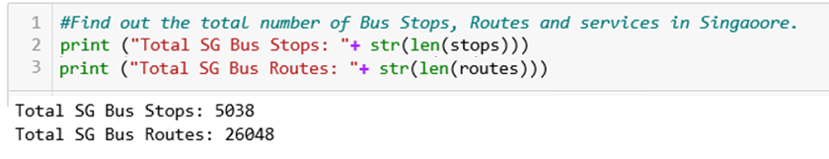
Interesting Facts
As per last check on 04 Feb 2020

Slide 20
Method 2 . Initializing of Network
Pair up the Bus Stop
Write the following from JSON data to the CSV file
Below is the example of Singapore Bus Dataset
Edge
Note: Point A or B are Bus Stop Number
Notes:
Selection are made on having the population that are closed to each other
Hougang VS Sengkang – Locate next to each other under NE region
Ang Mo Kio is the gateway between North and Centre and Chao Chu Kang is the gateway between North and West
Jurong West and Woodlands are located at the corner of Singapore and both are linked to Malaysia by Bridge
Explain the benefit/ Reason of Degree, Density, Clustering and Diameter

Slide 21
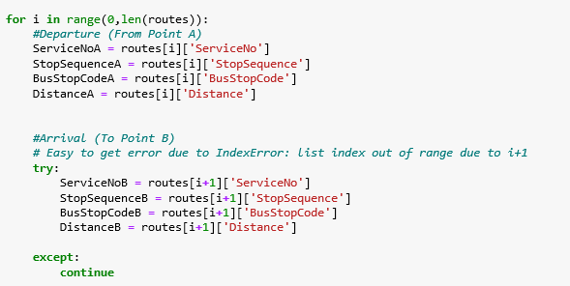
Method 2. Initializing of Network

Slide 22
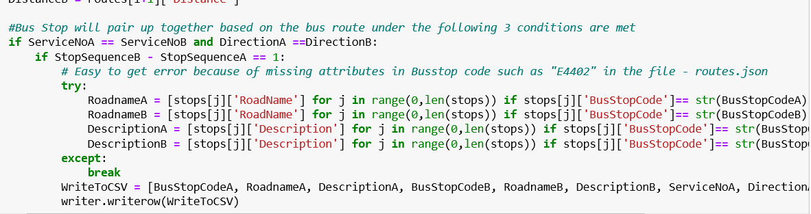

Method 2. Initializing of Network
2 Conditions for the bus stop pair
A
B
StopSequence
ServiceNo

Slide 23
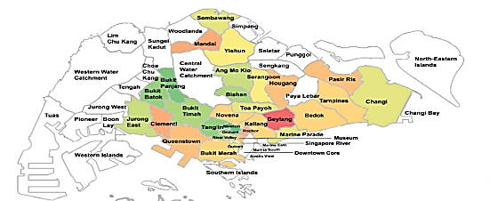
Method 3. Network Sub-Graph
To study for:
3 Mature Estate (Hougang, Ang Mo Kio, Tampines)
3 Non Mature Estate (Sengkang, Bt Batok, Woodlands)

Slide 24
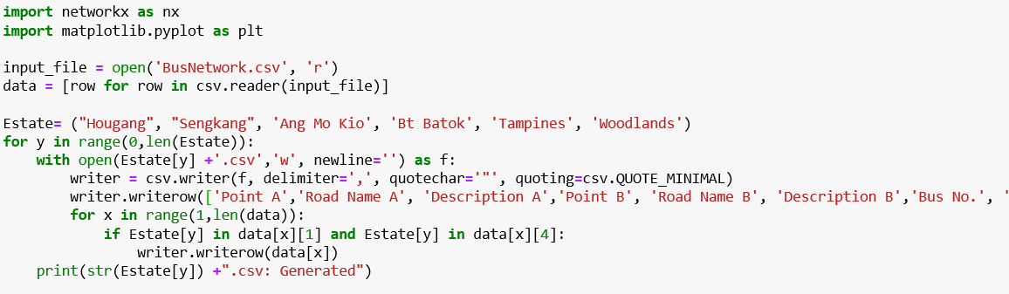
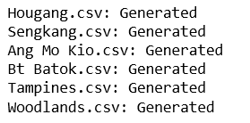
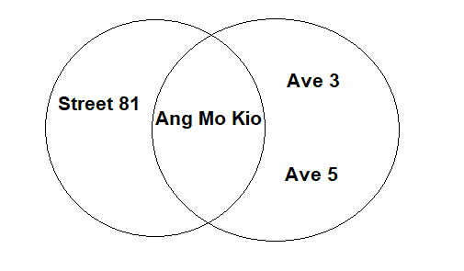
Method 3. Network Sub-Graph
Estate name is used as the Substring of the road name such as
“Ang Mo Kio” to find road name for:
Ang Mo Kio Street 81
Ang Mo Kio Ave 3 etc.
Common way for HDB to name the road

Slide 25
Only Green Nodes (denote as bus stop) within the estate are considered in the Study
Boundary (Estate)

Slide 26
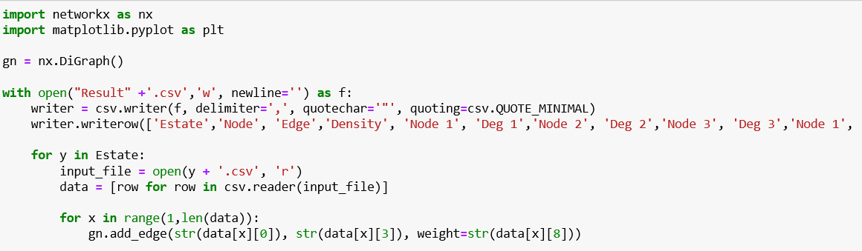
Method 4. Network Graph Establishment
Read from CSV file to define nodes, edges and weights of the directed graph
Python Module: Networkx

Slide 27
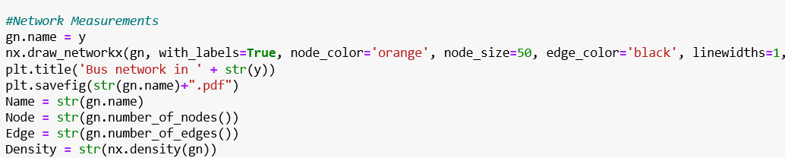
Method 5. Network Measurements
Degree, Node, Edge, Density

Slide 28
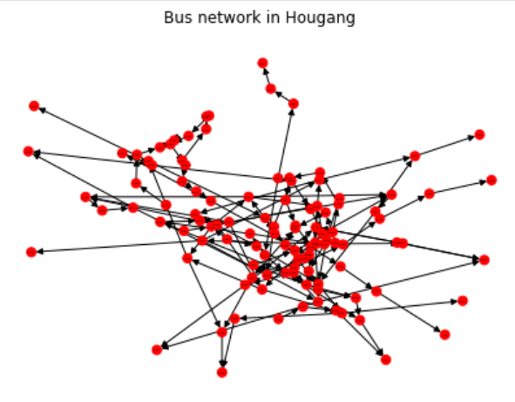
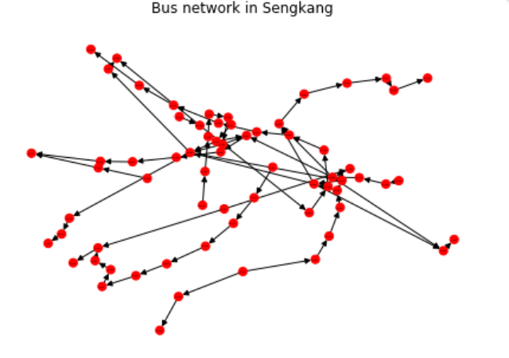
Network Graph
Estate | Nodes | Edges | Density | Node with Highest Degree | Node with Highest CC
Hougang | 110 | 142 | 0.01 | Hougang Ctrl Int (8) | Blk 512 (0.17) Blk 831 (0.17)
Senkang | 67 | 72 | 0.02 | Sengkang Community Hub (6) Block 323B (6) | Sengkang Int (0.17) Blk 234 (0.17)

Slide 29
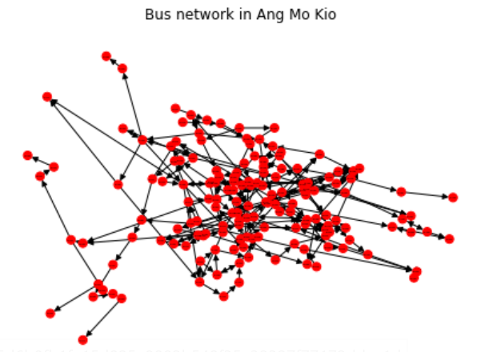
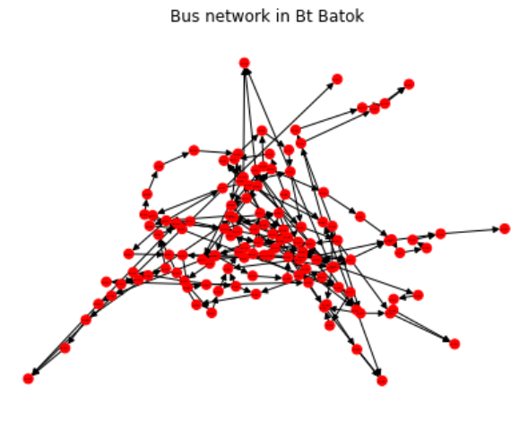
Network Graph
Estate | Nodes | Edges | Density | Node with Highest Degree | Node with Highest CC
Ang Mo Kio | 157 | 215 | 0.01 | Yio Chu Kang Int (10) | Sbst Ang Mo Kio Depot (0.167) Opp Yio Chu Kang Stadium (0.167) Aft Ang Mo Kio Stn Exit A (01.67)
Bt Batok | 129 | 182 | 0.01 | Bt Batok Int (8) | Blk 644 (0.167) Blk 225 (0.167) Aft Bt Batok West Ave 5 (0.167)

Slide 30
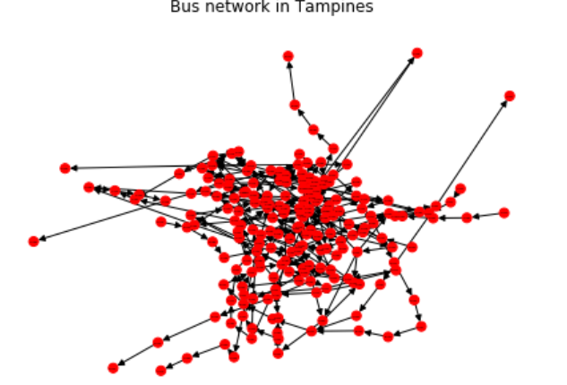
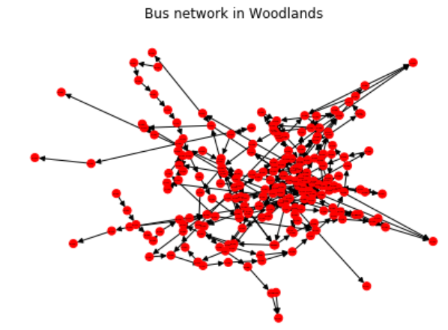
Network Graph
Estate | Nodes | Edges | Density | Node with Highest Degree | Node with Highest CC
Tampines | 200 | 276 | 0.01 | Tampines Int (10) | TAMPINES EAST STN EXIT B (0.167)
Woodlands | 210 | 266 | 0.01 | W'Lands Temp Int (12) | Blk 825 (0.08) Blk 803 (0.08)

Slide 31
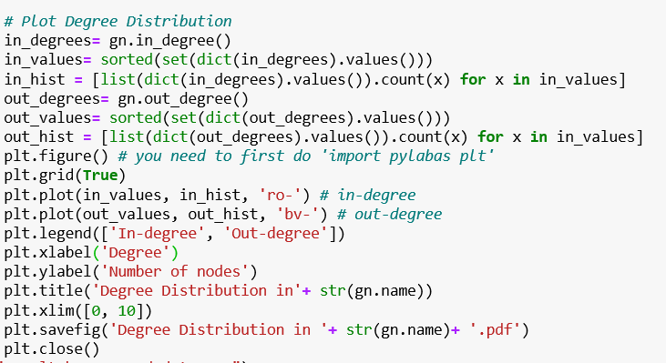
Method 5. Network Measurements
Degree Distribution Chart

Slide 32
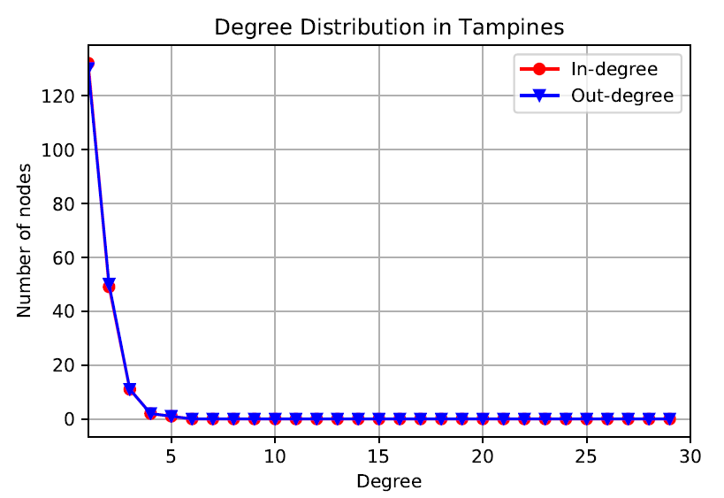
Degree Distribution

Slide 33
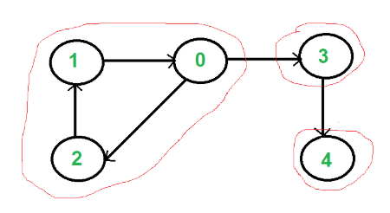
Method 6. Community Detection
Detect the community in each estate
Method: Strong Connected Components ????
In the graph, if we start search from vertex 0, we get vertices in stack as 1, 2, 4, 3, 0.
Consider 1,2,0 as the subgraph
Subgraph

Slide 34
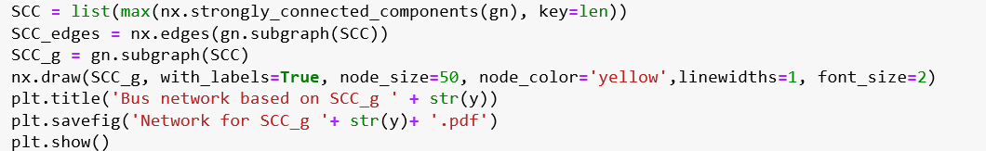
Method 6. Community Detection - Subgraph
Estate | Nodes | Edges
Hougang | 28 | 36
Sengkang | 3 | 3
Ang Mo Kio | 104 | 148
Bt Batok | 81 | 113
Tampines | 147 | 223
Woodlands | 139 | 182

Slide 35
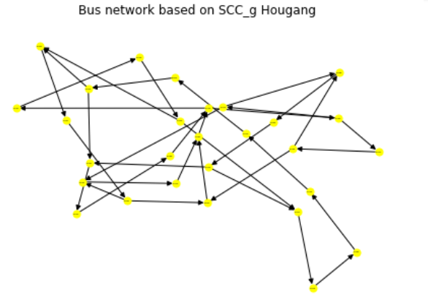
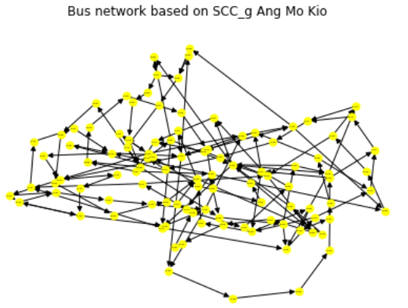
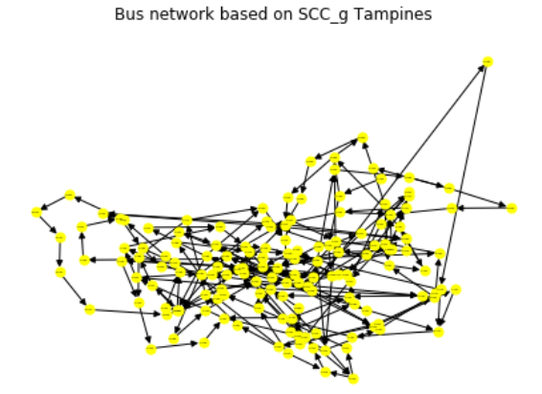
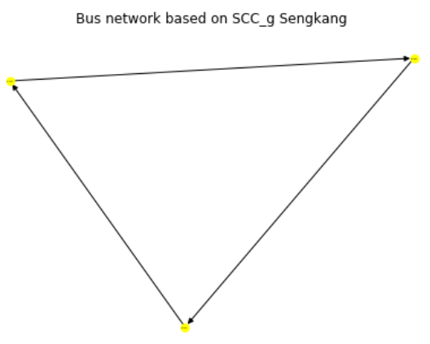
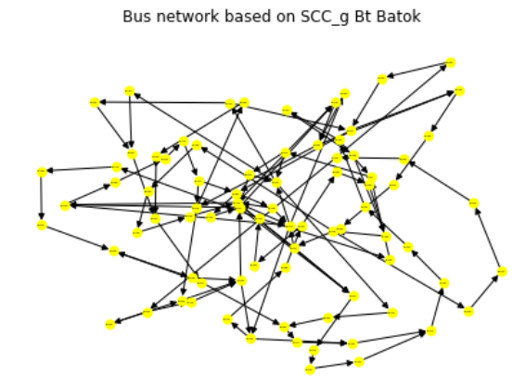
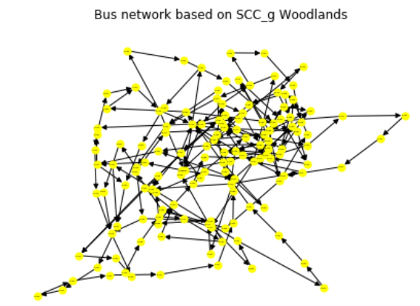
Method 6. Community Detection - Subgraph

Slide 36
Experiment
Ang Mo Kio vs Bukit Batok
Measure: Path length & Diameter
To analyse how quickly a commuter is able to travel from one bus stop (node) to another bus stop
Woodlands vs Tampines
Measure: Clustering Coefficient
To analyse the connectivity of each bus stop (node) to another bus stop
Hougang vs Sengkang
Measure: Centrality
To identify the key player and analyse whether the bus stop (node) is sufficiently equipped for high traffic flow

Slide 37
Ang Mo Kio VS Bukit Batok
Estate | Nodes | Edges | Diameter (Link) | Path_length (KM)
Ang Mo Kio | 104 | 148 | 22 | 9.75
Bt Batok | 81 | 113 | 24 | 9.45

Slide 38
Tampines vs Woodlands
Estate | Average Clustering Coefficient
Tampines (Mature) | 0.004
Woodlands (Non-Mature) | 0.0006

Slide 39
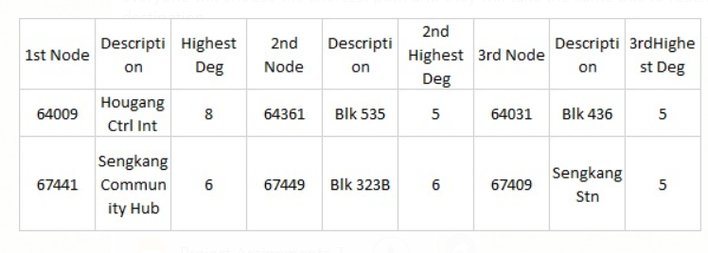
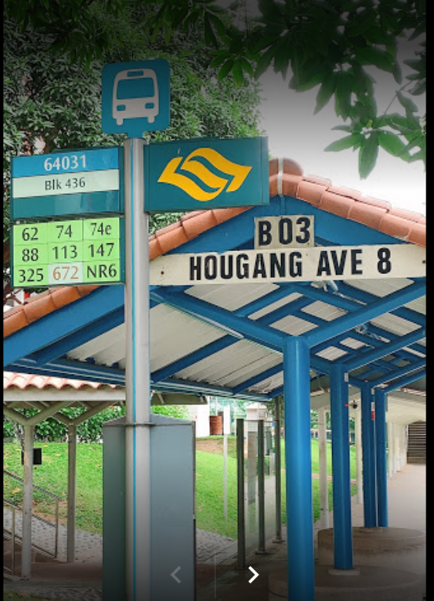
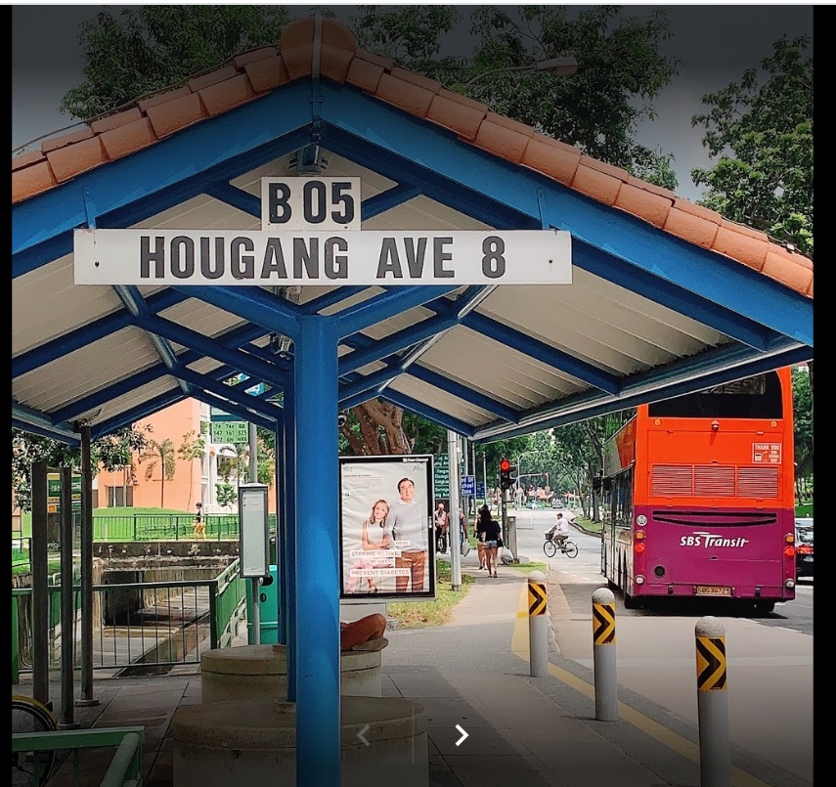
Hougang vs Sengkang

Slide 40
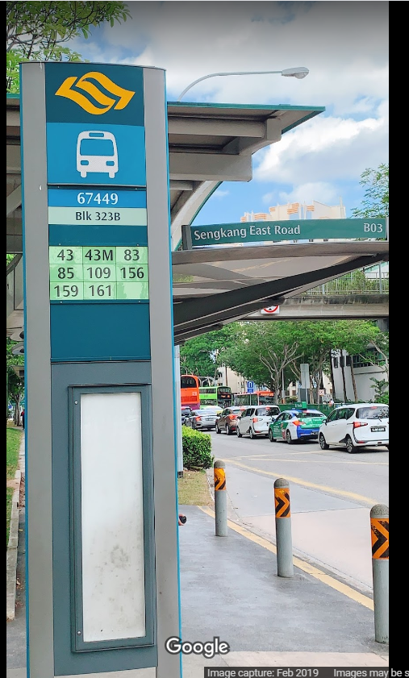
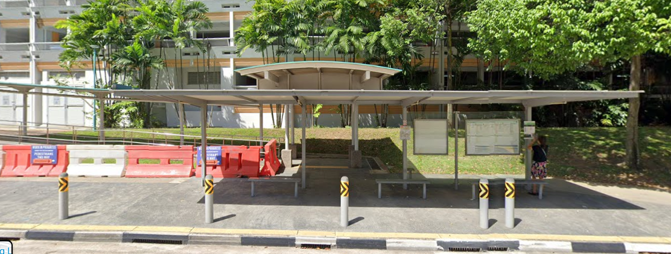
Hougang vs Sengkang

Slide 41
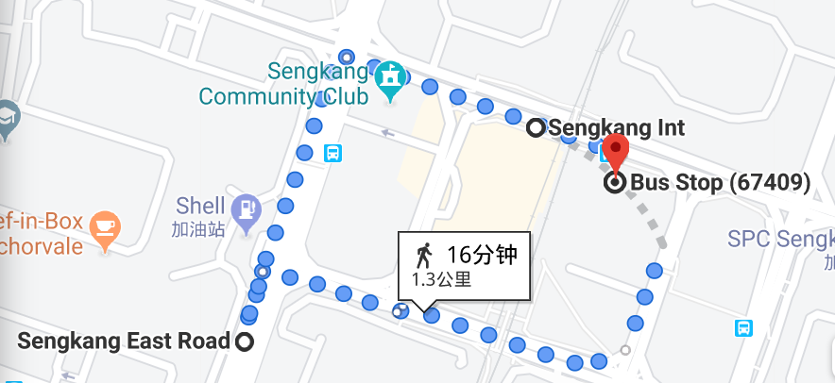
Centrality Measure for key player
Sengkang
Highest Betweenness Centrality:0.5
Sengkang Station
Sengkang East Rd
Sengkang Sq

Slide 42
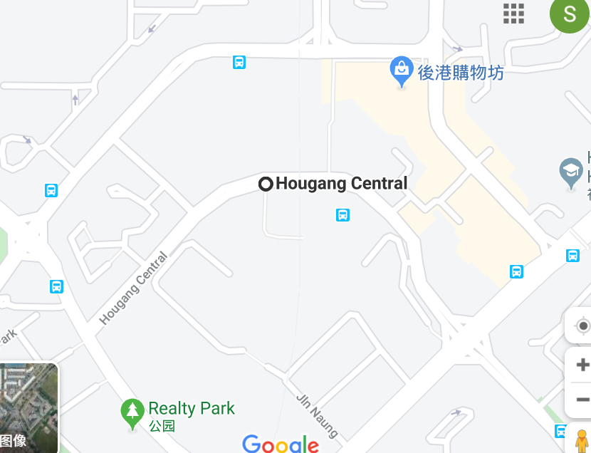
Centrality Measure for key player
Hougang
Highest Betweenness Centrality : 0.61
Hougang Central

Slide 43
Conclusion and Recommendation
Algorithm: Community Detection
New relationship(link) to explore between the nodes

Slide 44
Reference
https://en.wikipedia.org/wiki/Population_White_Paper
https://www.teoalida.com/singapore/hdbresaleflatpricesdatabase/
https://www.citypopulation.de/en/singapore/cities/
https://www.mytransport.sg/content/mytransport/home/dataMall.html
http://www.lihaoyi.com/post/PlanningBusTripswithPythonSingaporesSmartNationAPIs.html#improvements
https://services2.hdb.gov.sg/webapp/BB33RTIS/BB33PReslTrans.jsp
https://networkx.github.io/documentation/stable/

Slide 45
Thank you!!!

